Slide 1
CUSTOMER RETENTION CASE STUDY
Data analysis
by
Ganesh kumbhar

Slide 2
Problem statement:
E-retail factors for customer activation and retention: A case study from Indian e-commerce customers
Customer satisfaction has emerged as one of the most important factors that guarantee the success of online store; it has been posited as a key stimulant of purchase, repurchase intentions and customer loyalty. A comprehensive review of the literature, theories and models have been carried out to propose the models for customer activation and customer retention. Five major factors that contributed to the success of an e-commerce store have been identified as: service quality, system quality, information quality, trust and net benefit. The research furthermore investigated the factors that influence the online customers repeat purchase intention. The combination of both utilitarian value and hedonistic values are needed to affect the repeat purchase intention (loyalty) positively. The data is collected from the Indian online shoppers. Results indicate the e-retail success factors, which are very much critical for customer satisfaction.

Slide 3
Understanding of the problem statement.
Customer satisfaction is the key factor to success of E-Retails. 5 things can bring the increase in customer satisfaction.
Service Quality.
System Quality.
Information Quality.
Net Benefits.
Trust.
The data for CUSTOMER RETENTION CASE STUDY was collected from the Indian online shoppers through a survey & its result indicates the e-retail success factors. It has been already known that customer satisfaction is the key factor to retain & activate the customers. But there is 5 major factors of customer satisfaction: Service Quality, System Quality, Information Quality, Net Benefit & Trust. The data was collected to study these 5 factors of customer satisfaction & to understand the behavior of customer. But the results are very critical for customer satisfaction.

Slide 4
Understanding the data
Dataset was collected from Indian Online Shoppers through a survey.
Dataset has various Questions & Statements with some options from which customers had to choose options as per their ideal e-retail store.
Dataset was recorded in MS Excel format are being used as same.
Dataset has a total of 71 Columns & 269 rows, that means 269 people’s record were saved for 71 questions or statement.
Dataset has no missing values, all records were neat & clean.
All the columns in Dataset is categorical.
The data type of all the column was OBJECT Data Type except Pin Code Column, it was INTEGER Data Type column. Later we changed it into object Data Type for our convenience.

Slide 5
Software, tools & Libraries used in project
Python Programming language in Jupyter NoteBook is used for this project.
Anaconda software provided all of the above mentioned thing in one platform.
Pandas Library is used to read the data in python programming language.
Numpy Library is used for mathematical implementation in the dataset.
Matplotlib & Seaborn libraries used for plotting and visualizing the statistical analysis of the data

Slide 6
Exploratory data analysis & their findings
Matplotlib & seaborn library have played the significant role in exploratory data analysis of customer retention case study.
The whole project’s development, finding of data & conclusion are based on count plot statistical tool of seaborn library.

Slide 7
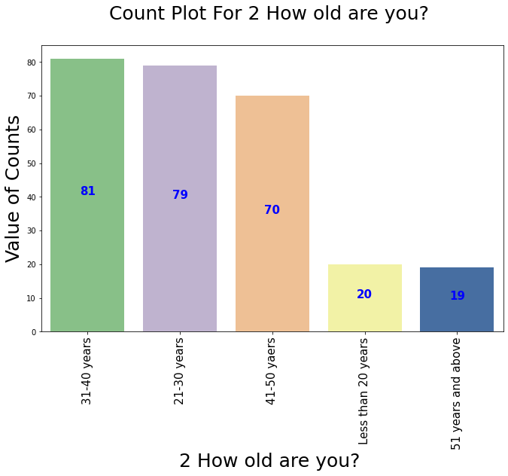
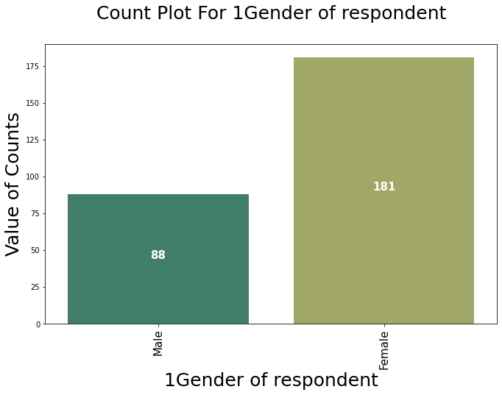
Study of respondent & their backgrounds.
Gender
Out of 269 respondents 181 respondents are Female.
The count of Male respondents is 88.
The Ratio of Gender clearly indicates that Females are More Online Shoppers.
Age
Maximum people’s age are in range 31-40 years.
21-30 years age range peoples are just 2 counts behind the 31-40 years.
The above 2 age range are the most young & independent, this combination making them the frequent consumers.

Slide 8
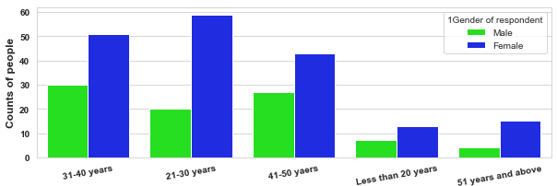
Relationship between age and gender of respondents
On Further analysis of Age and Gender of the respondents, we found that females are dominating the males in all age categories.
21-30 years the youngest independent women are more online shoppers.
31-40 years male are more online shoppers.
We found above 51 years male & females are also online shopper, though their number is less but still there.

Slide 9
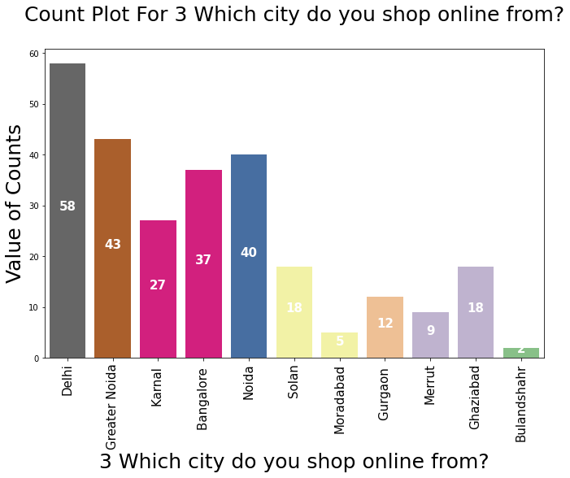
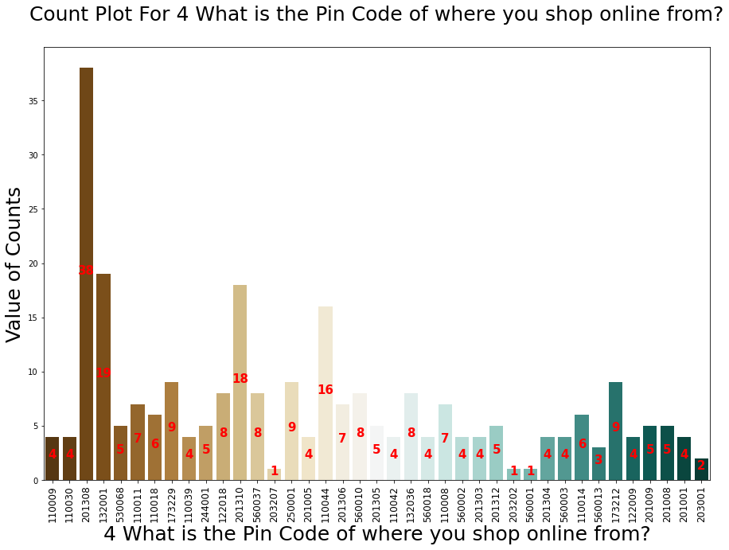
City of respondents or shopping city.
City:
Maximum respondents are from Delhi city.
Also out of 11 city 5 cities are of Delhi NCR.
From these observations we can say that Delhi NCR is the hub of online shopping. These city can decide the success of E-Commerce companies.
Pin codes:
Highest numbers of pin codes belongs to Delhi city alone.
That means online shopping trend is in all over the Delhi.
Highest numbers of online shoppers belong to 201308 Pin Code-Noida.

Slide 10
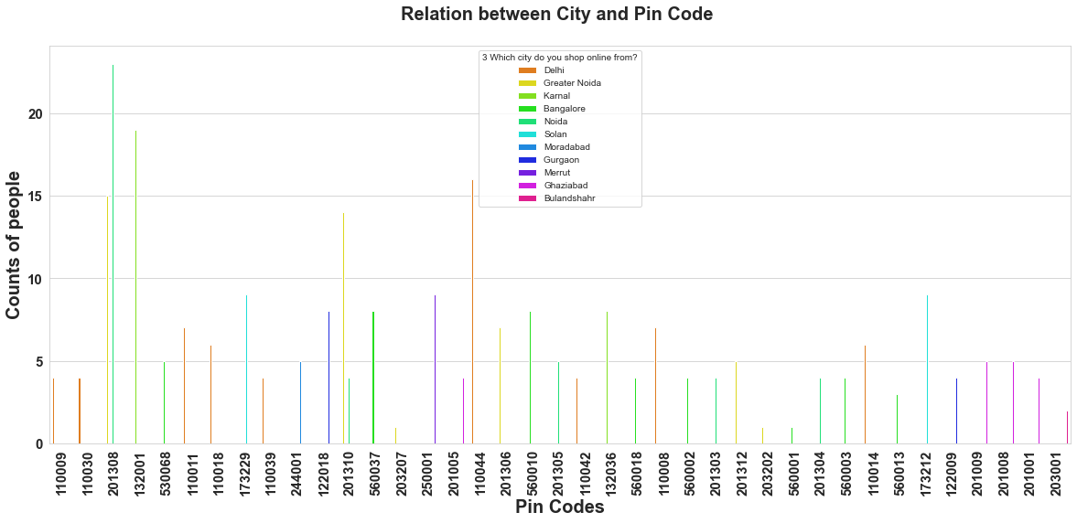
Relationships between pin city & pin codes
We can see that 201308 pin code has highest counts & has 2 bars and the colors of bar represents the Greater Noida & Noida respectively.
Count of Red Bars are the highest & Red bar represents the Delhi city. Means Online shopping in Delhi is all over spread.

Slide 11
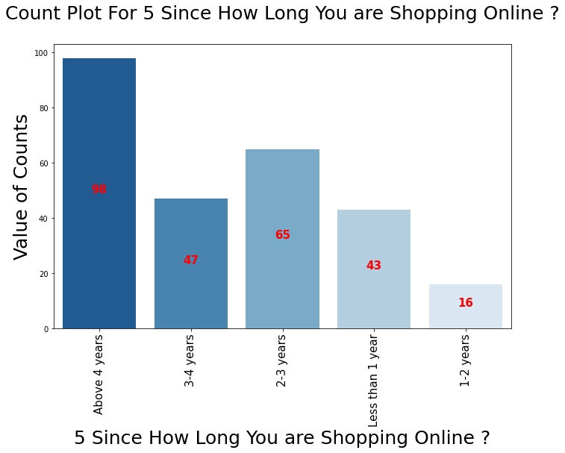
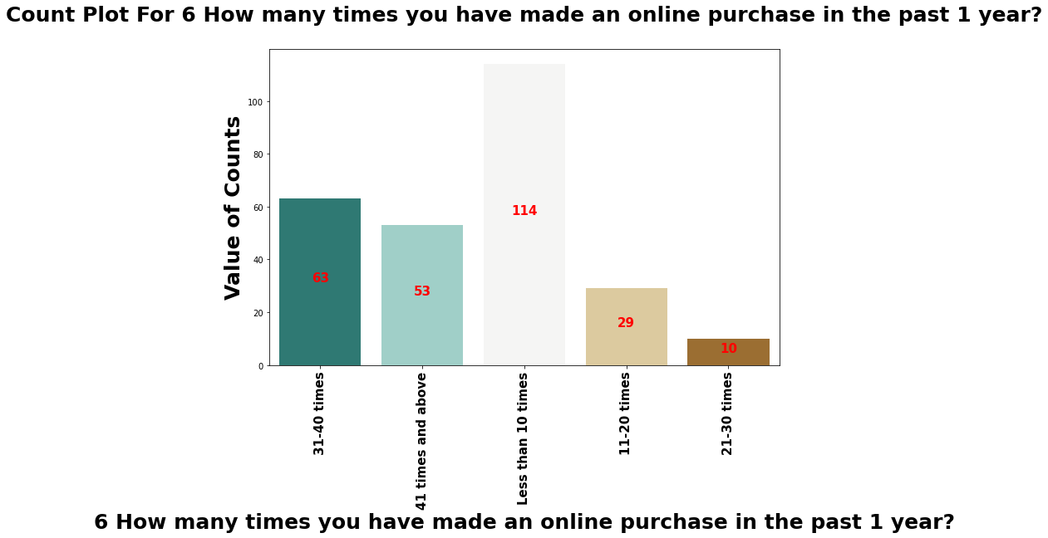
Shopping experience & past 1year total purchase
Majority of people are shopping online since more than 4 years.
1-2 years online shopping experience people are very less even less than 1 year experience holders are higher in number against them.
Even though people have online shopping experience & awareness since long time, still majority of people’s last 1 year purchase is less than 10 purchase.
This clearly proves that customer retention is quite complicated.

Slide 12
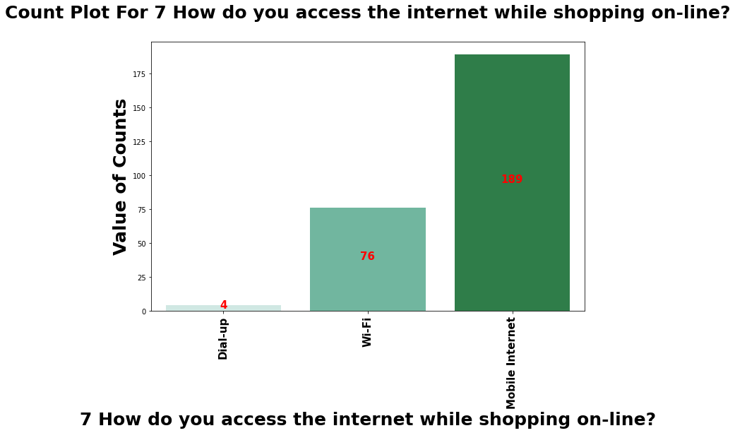
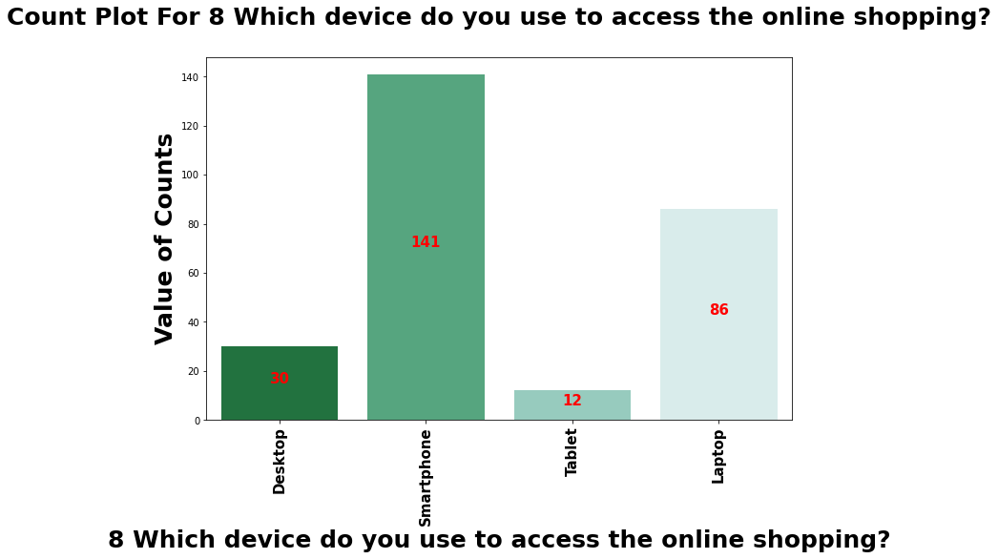
Connectivity & Devices used. Smart phone is the most used device for the surfing of internet world & hence mobile internet is the most used internet service for the connectivity.

Slide 13
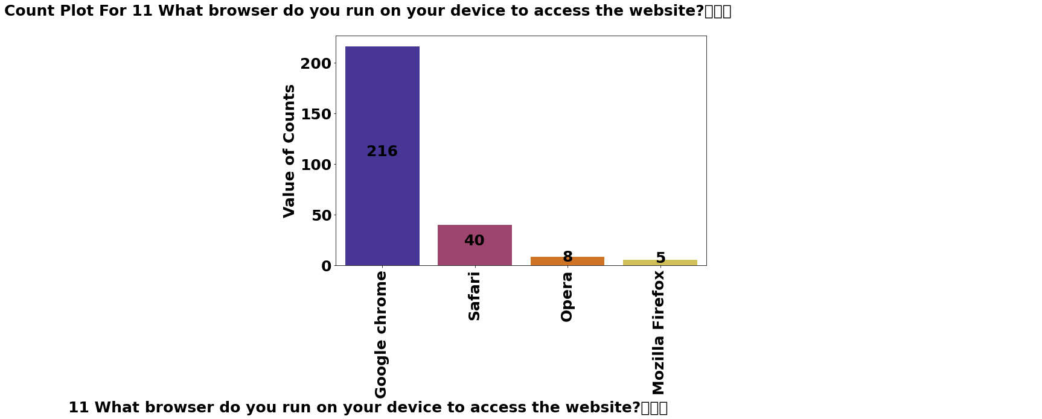
Browser to surf internet.
Google Chrome is the most famous Search Engine to search on internet, browse internet, visit websites hence people will most likely use Google Chrome maximum to search for their needs.

Slide 14
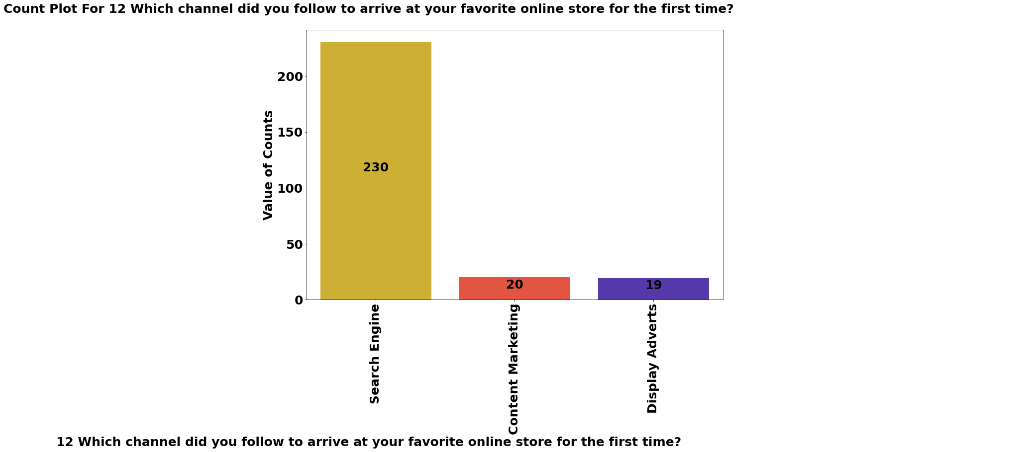
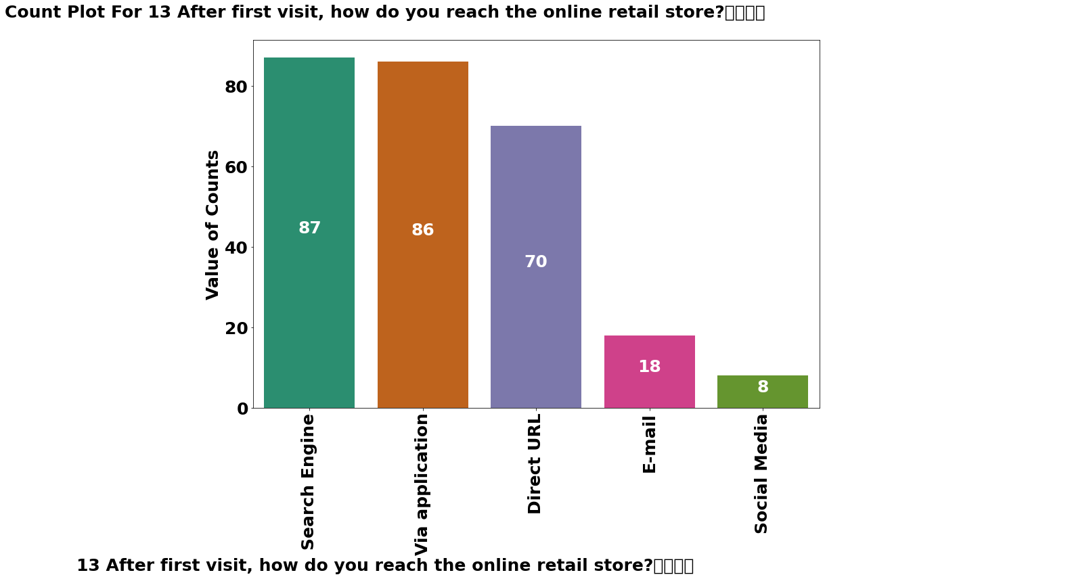
Arriving at the favorite online store Earlier we studied that google chrome is the most used search engine to browse internet search things online & we assumed that while searching their needs online will most likely take them to their favorite online store. Hence here it is proved that most people arrived at their favorite online store via search engine. After that half of the people started using application while half of them continued with search engine only.

Slide 15
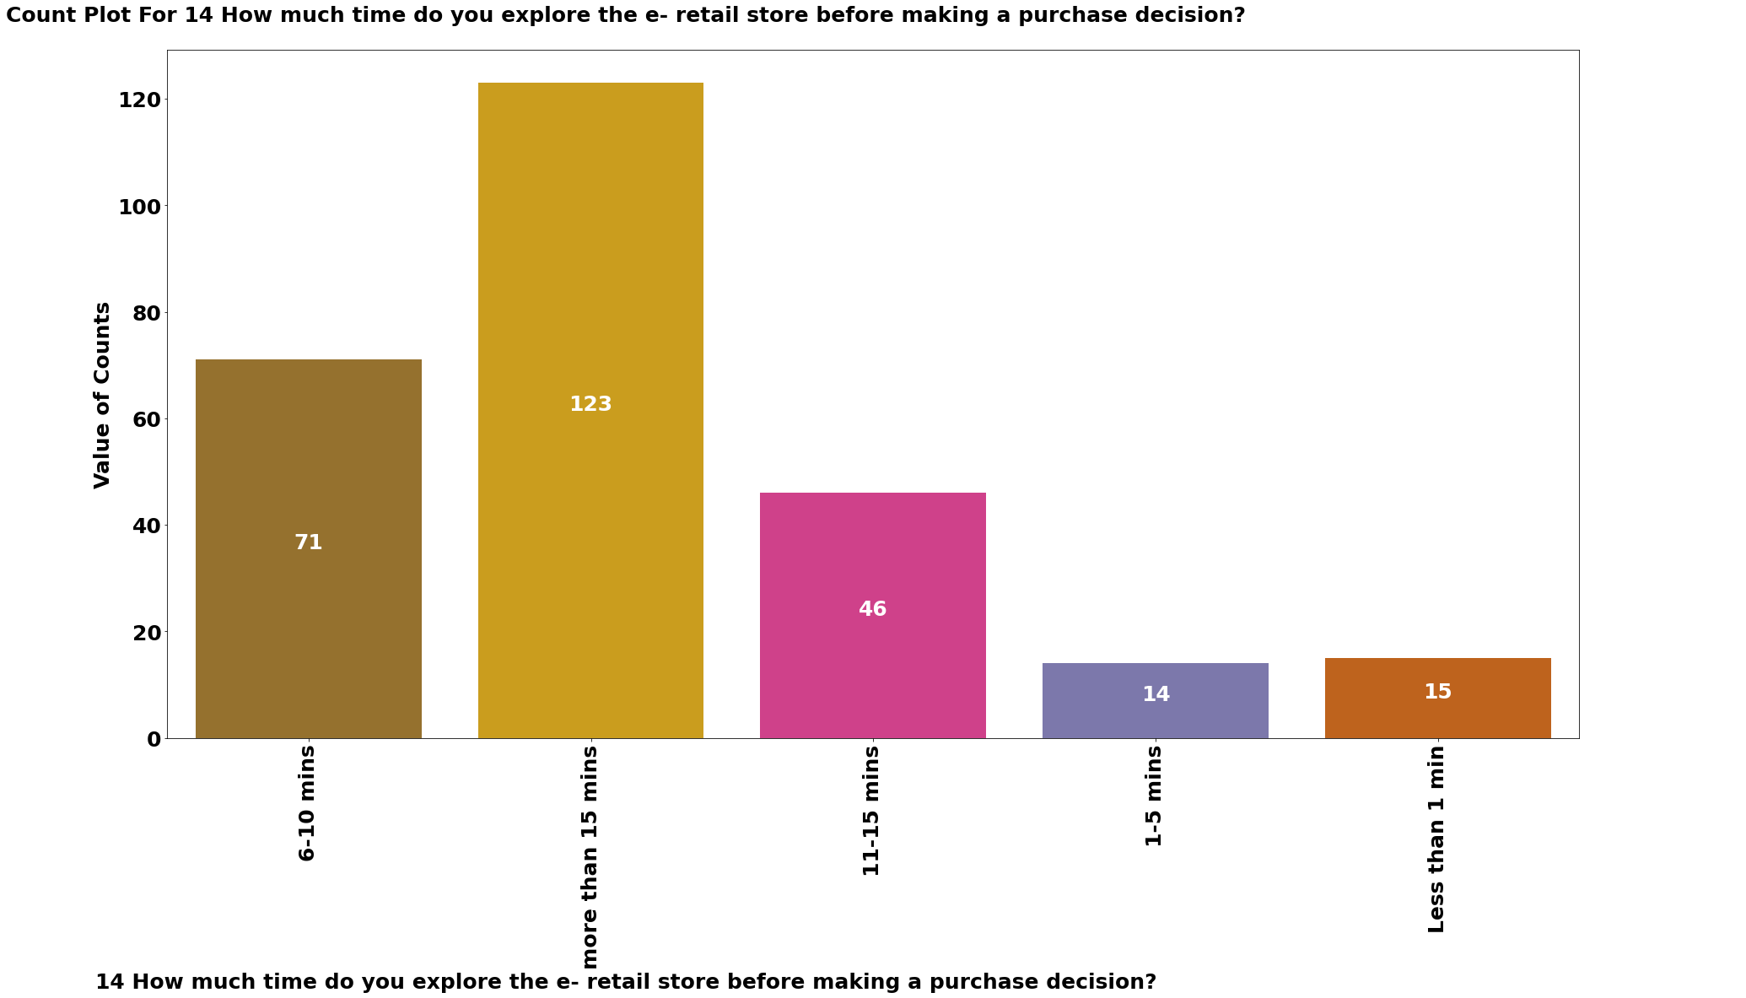
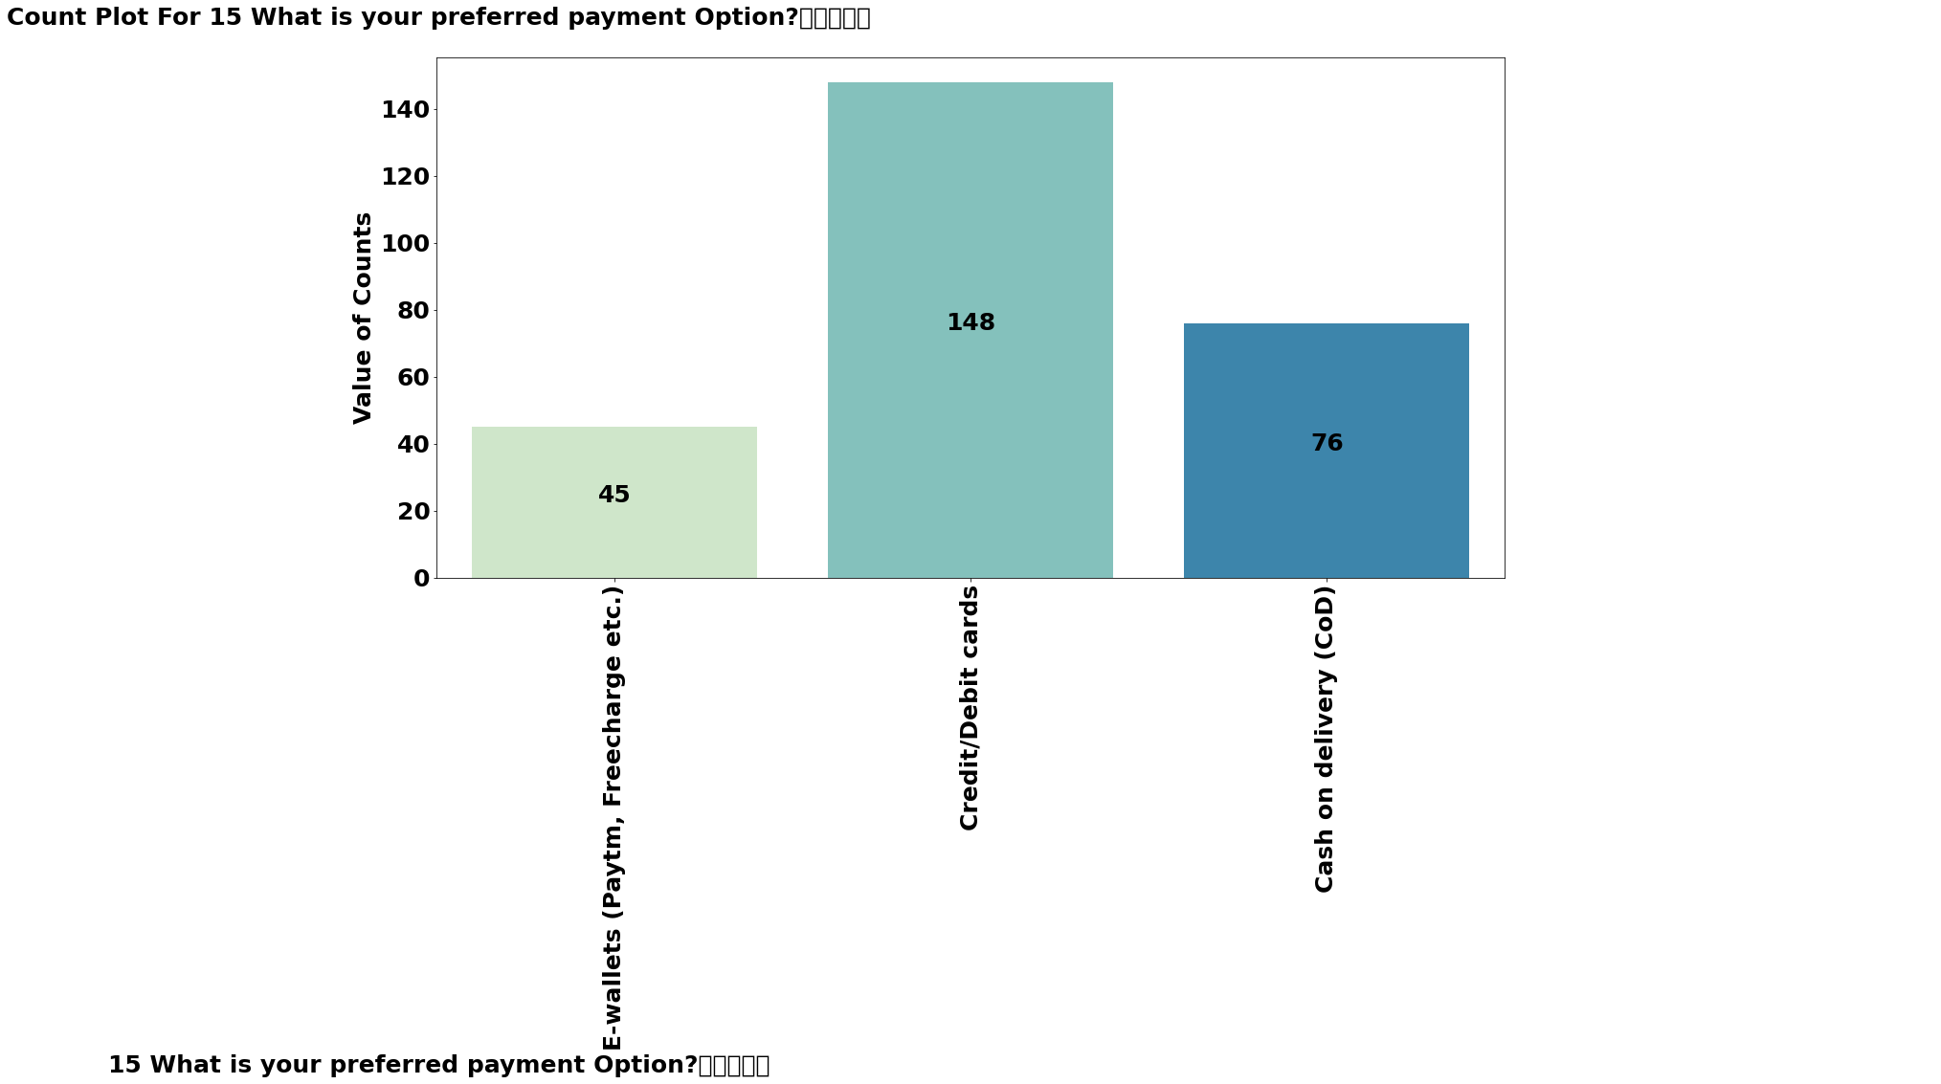
Time spent on website before making purchase & Preferred payment options
Most people use to spend time more than 15 minute while making a purchase this thing indicates that people use to research about the products, alternate options better price and all the things like that.
Debit card or credit cards are the preferred payment options of the people. Cash on delivery are still the 2nd options for the people.

Slide 16
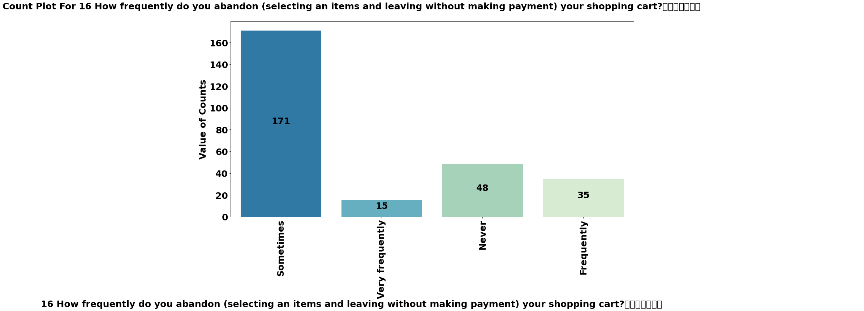
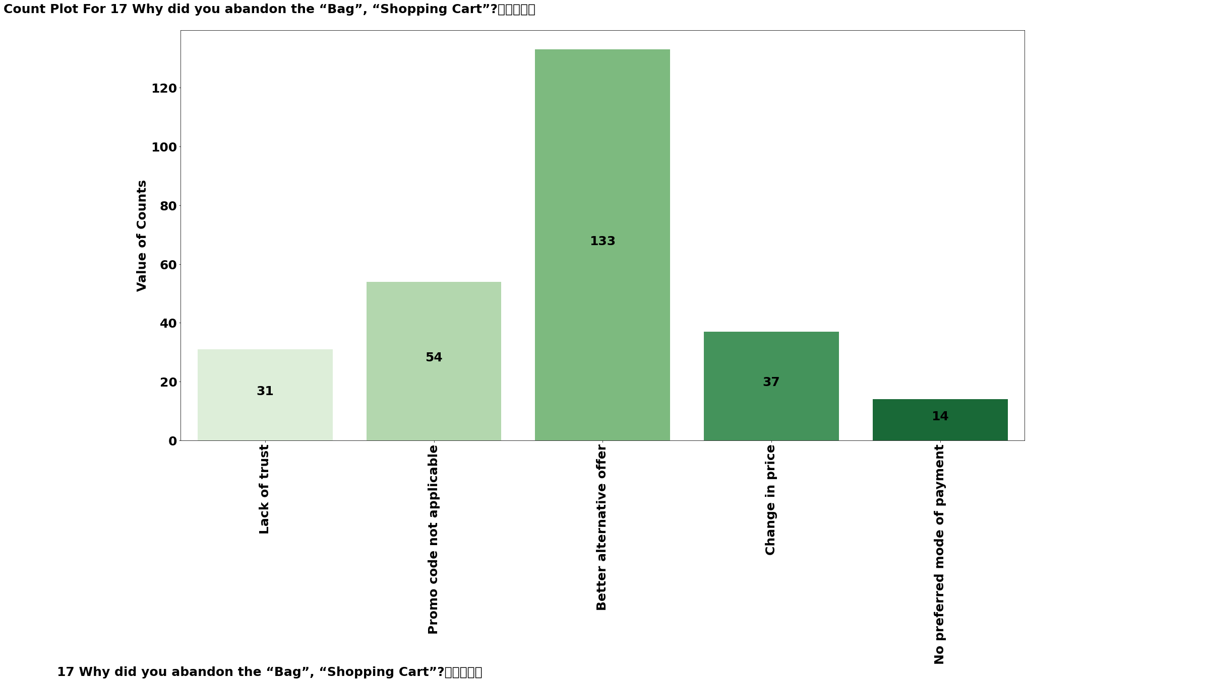
Why to abandoned the cart? Most people sometimes use to abandon the shopping cart before making purchase. We already researched and found that people use to do more and more research before buying anything and sometimes they are abandoning the cart. This arise a question why people waste their time when they are not going to buy. The answer to this question we found that while researching people gets better options or better alternative offers & hence the previous cart gets abandoned.

Slide 17
What facility & services an ideal online store should have?
After gaining the some basic information about customer’s background in the survey, the customer’s point of view have been taken regarding the facility, & services of the online store as rating to the statements on what facility or services an online store should have. There were 30 statements in the survey form, which is recorded in excel file from column no. 18 to 47 & respondents have to give their view as they are agree or disagree with the mentioned statement regarding the online stores. Rating was to be given out of 5 in which 1 represents the STRONGLY DISAGREE, 5 represents the STRONGLY AGREE, 3 as INDIFFERENT, 2 as DISAGREE & 4 as AGREE.
These survey ratings by the respondents clearly defines that what is customer’s need and choice when it comes to shopping online through E-Retail & working on these or providing these facilities and services to the customer will lead to success for E-Retail store.
Let’s have a look at these data and conclude the analysis.

Slide 18
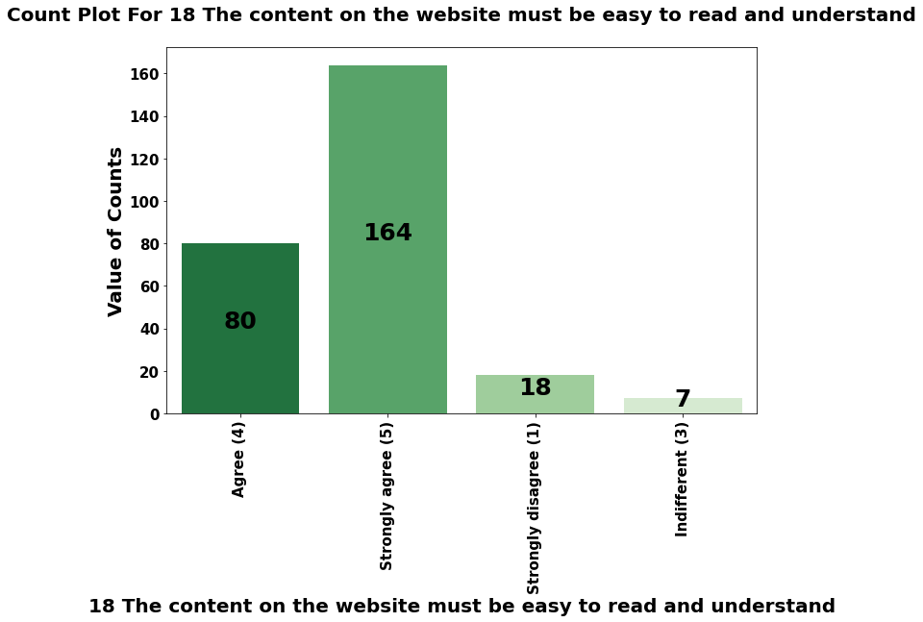

Slide 19
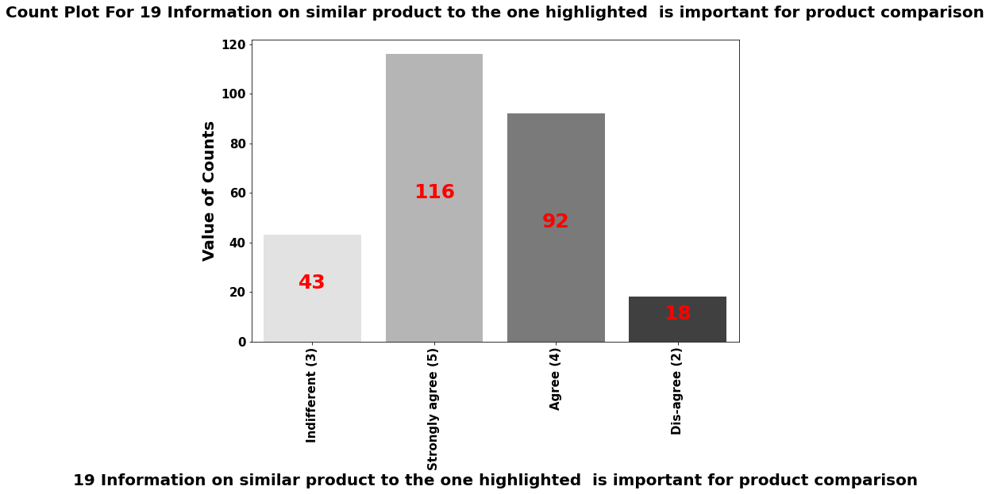

Slide 20
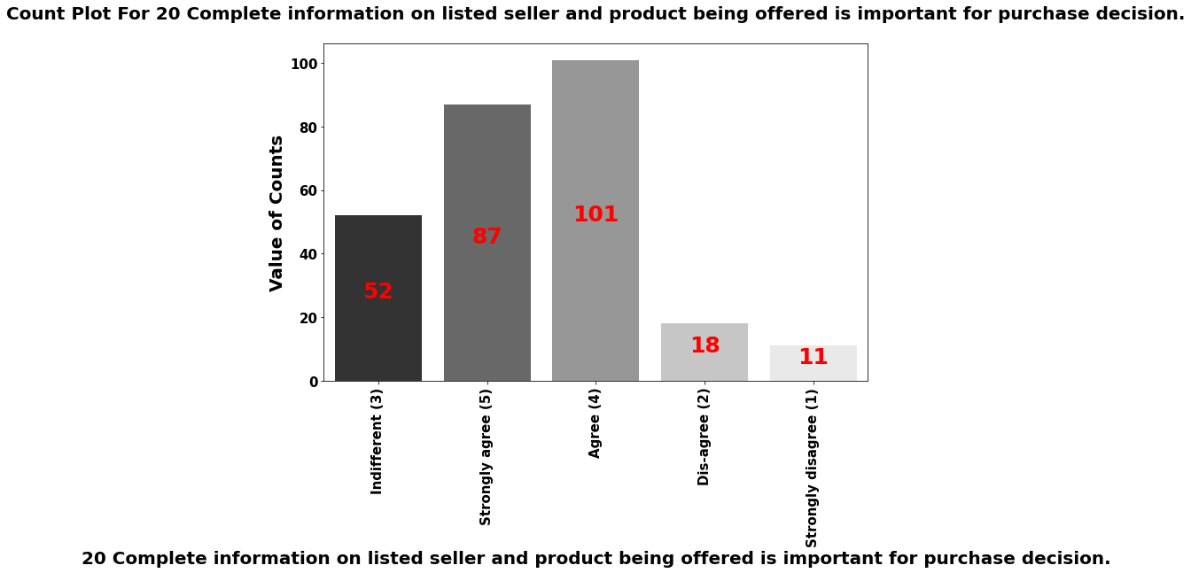

Slide 21
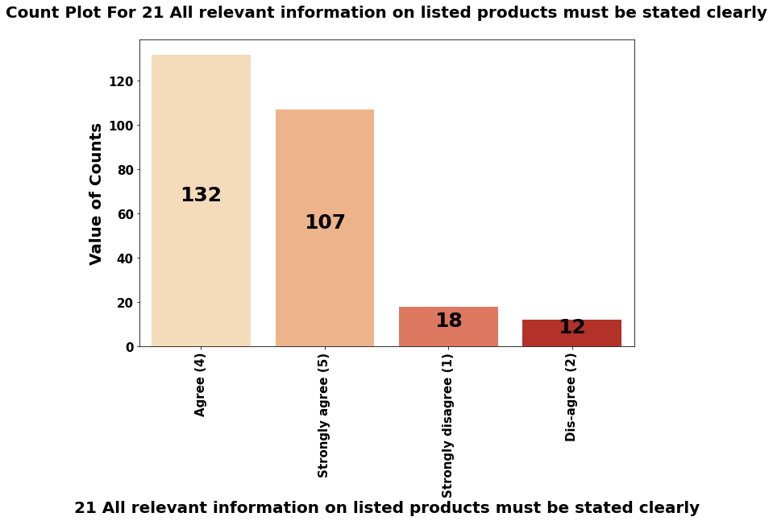

Slide 22
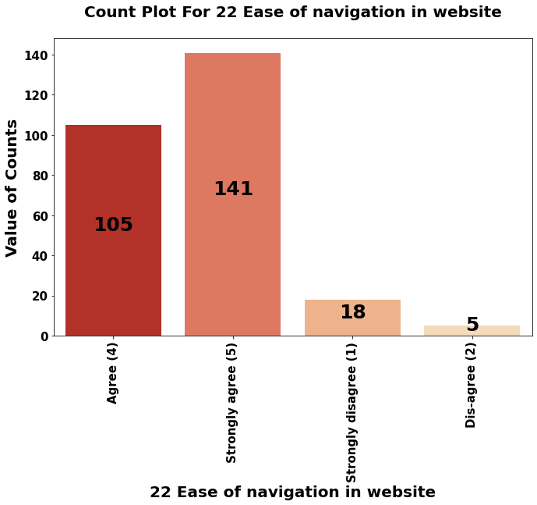

Slide 23
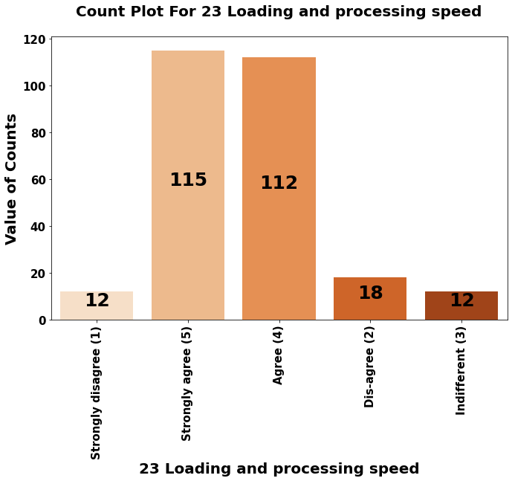

Slide 24
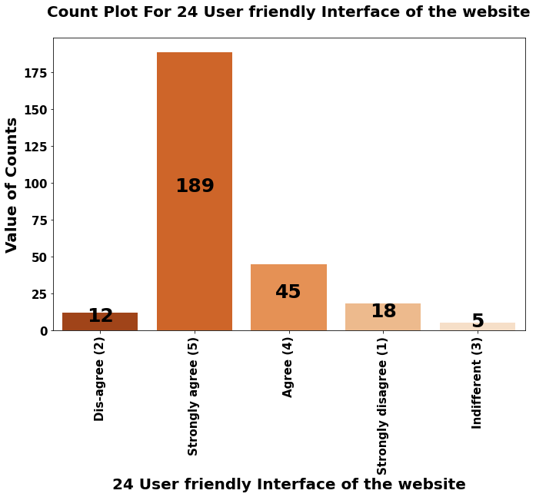

Slide 25
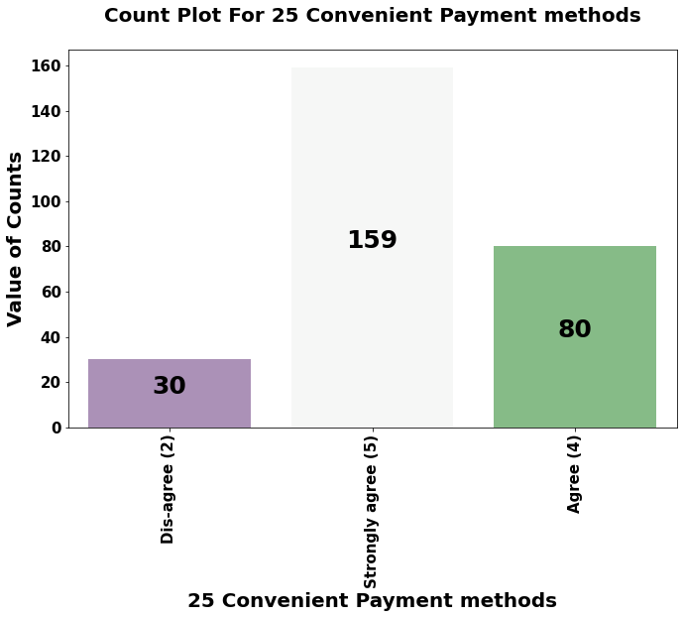

Slide 26
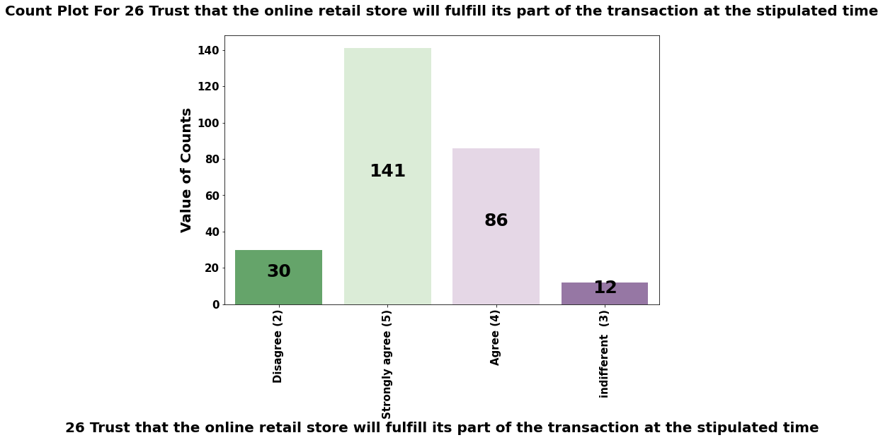

Slide 27
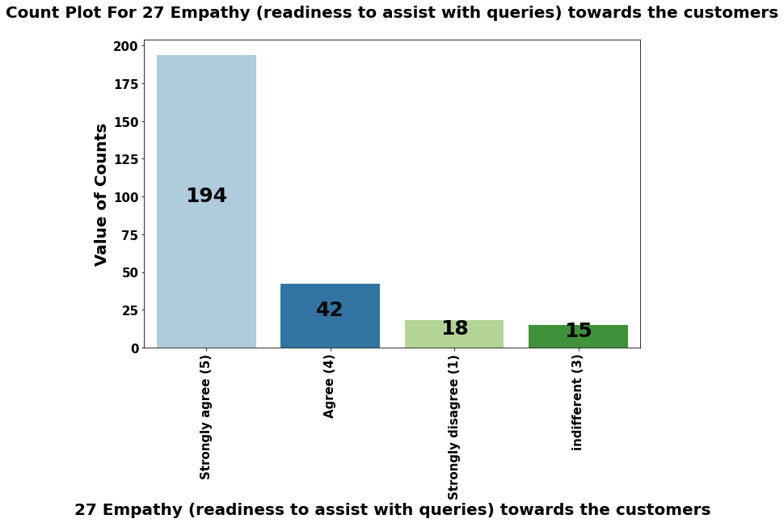

Slide 28
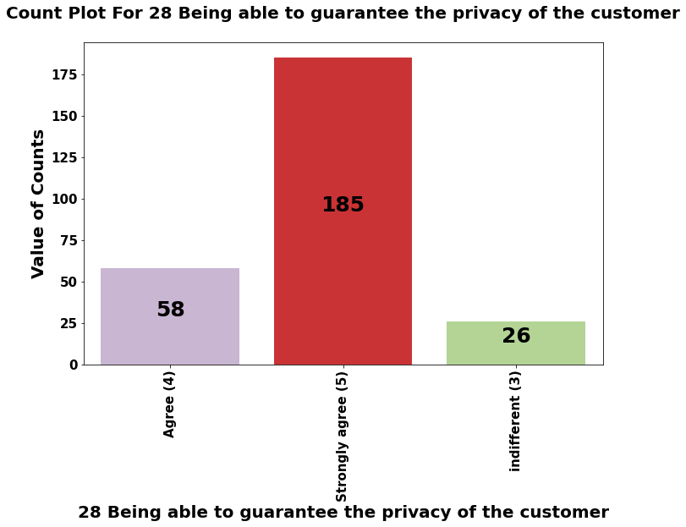

Slide 29
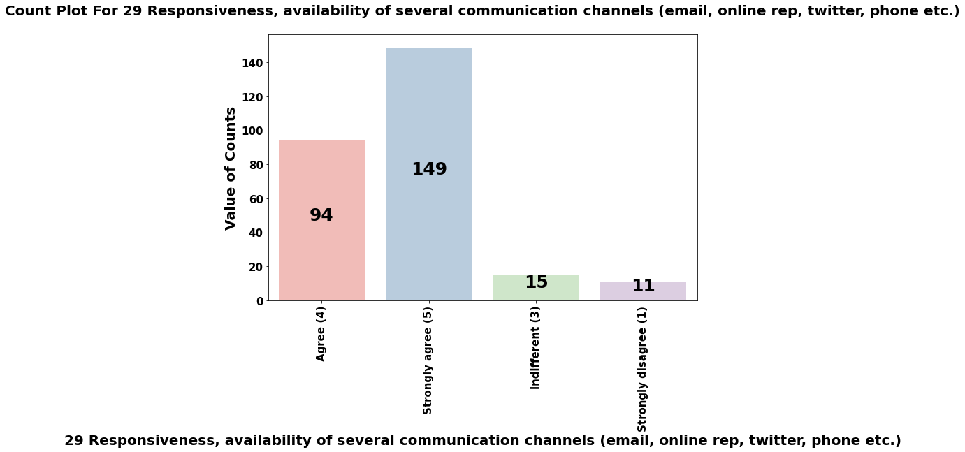

Slide 30
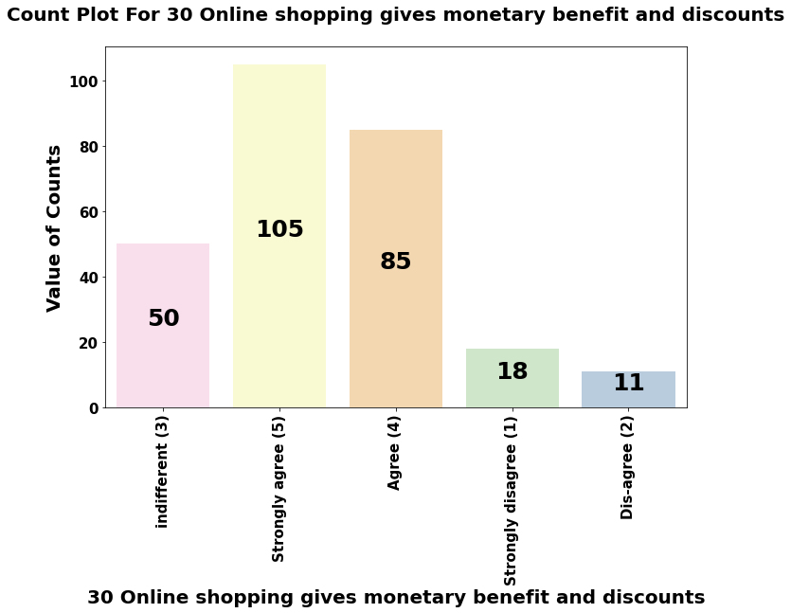

Slide 31
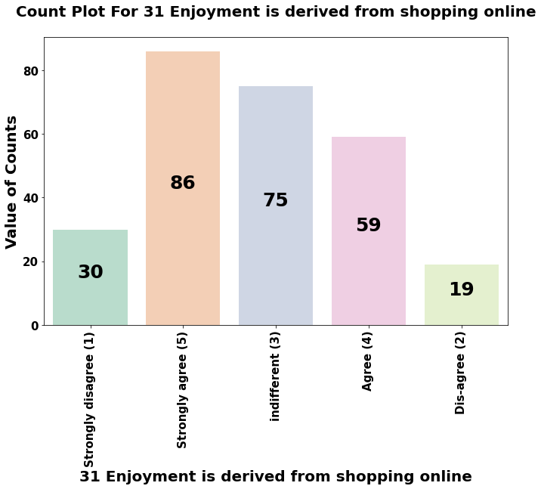

Slide 32
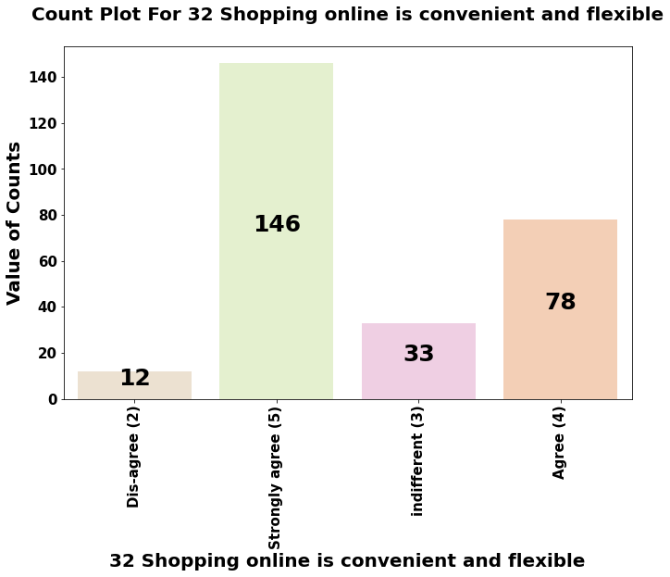

Slide 33
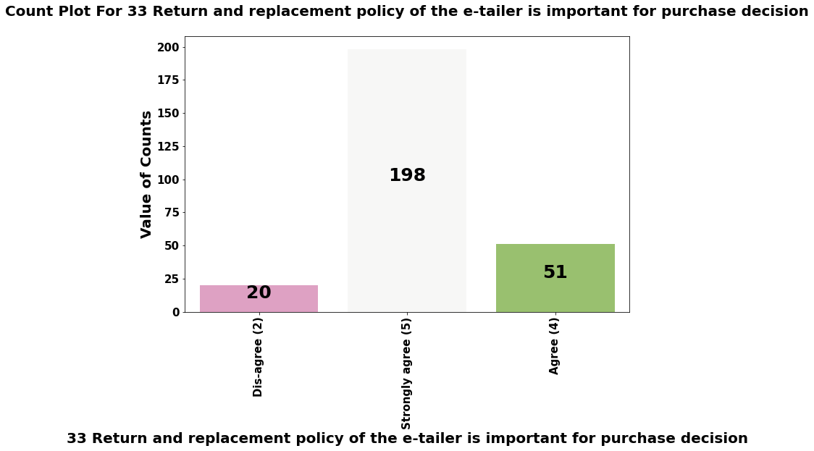

Slide 34
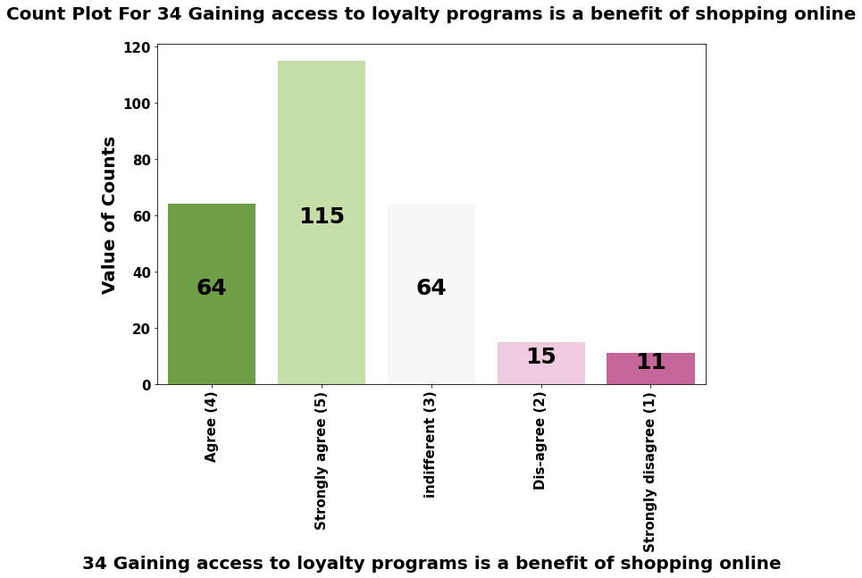

Slide 35
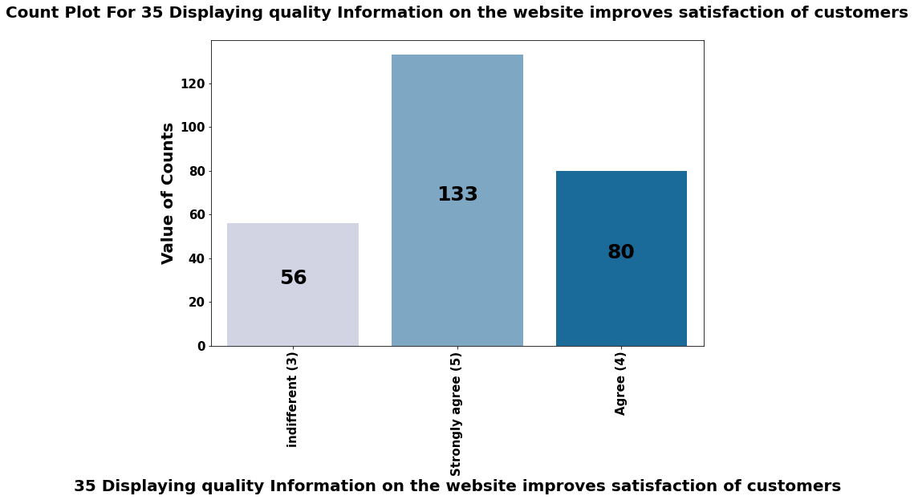

Slide 36
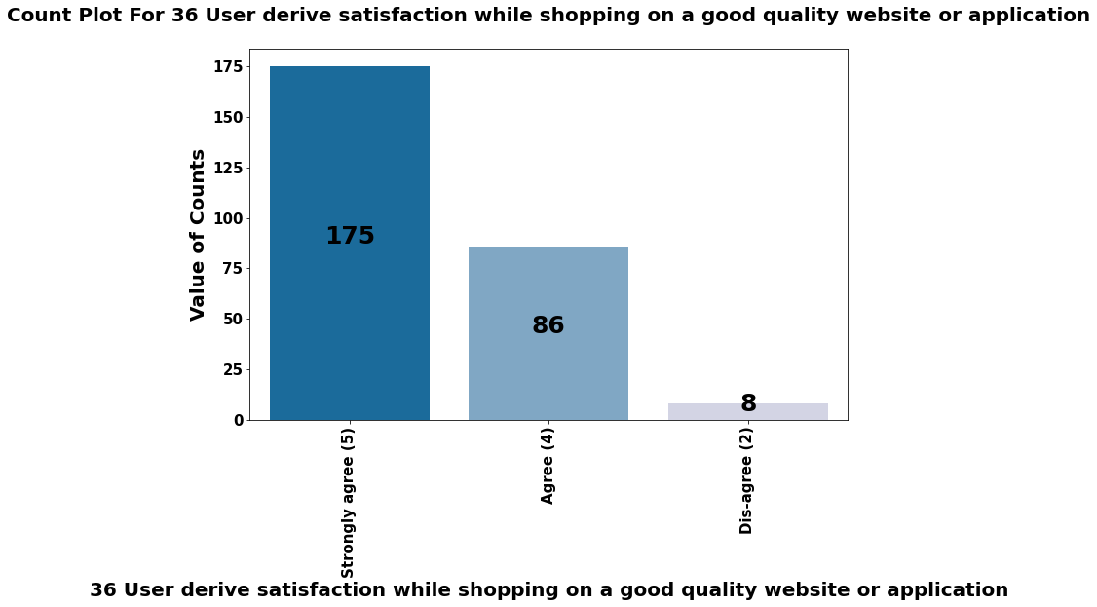

Slide 37
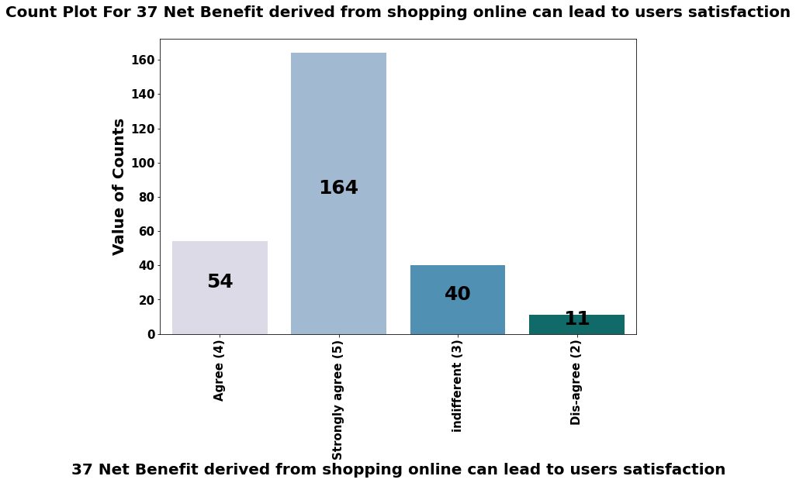

Slide 38
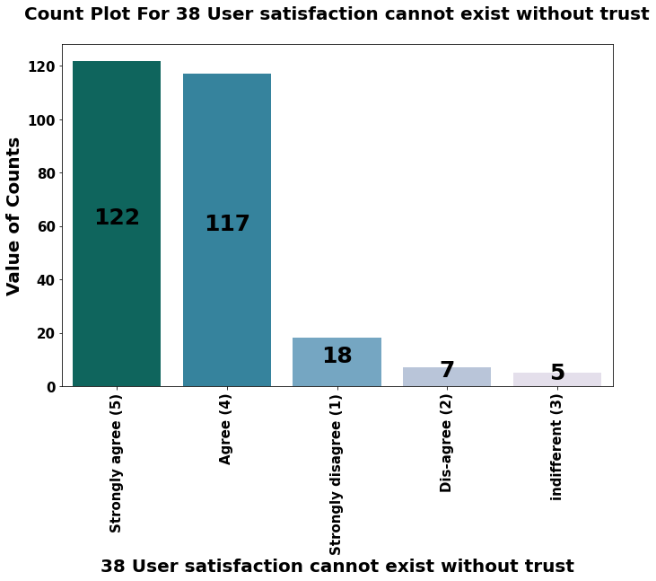

Slide 39
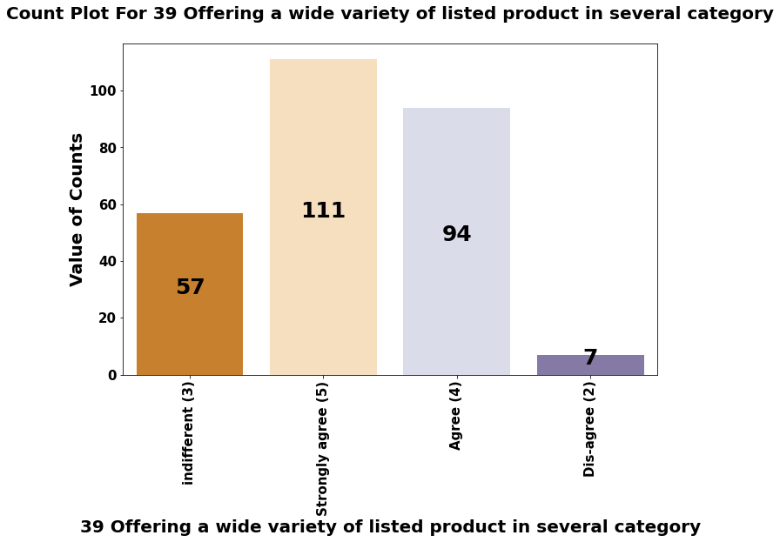

Slide 40
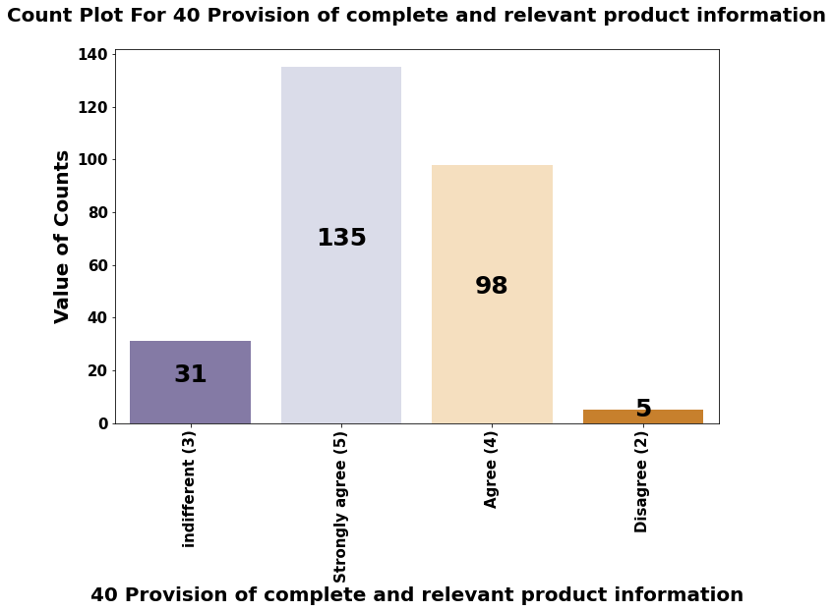

Slide 41
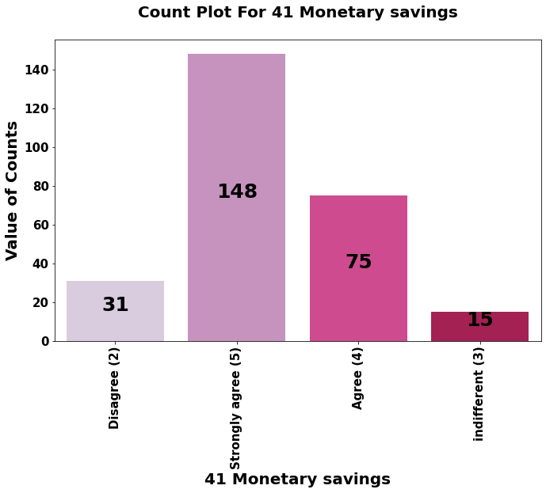

Slide 42
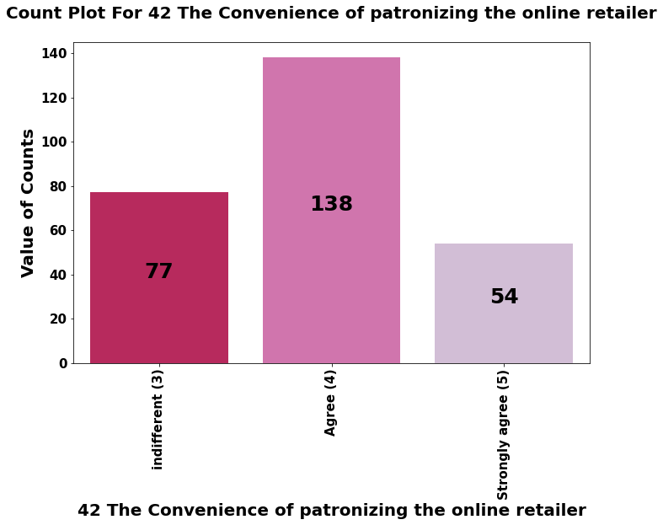

Slide 43
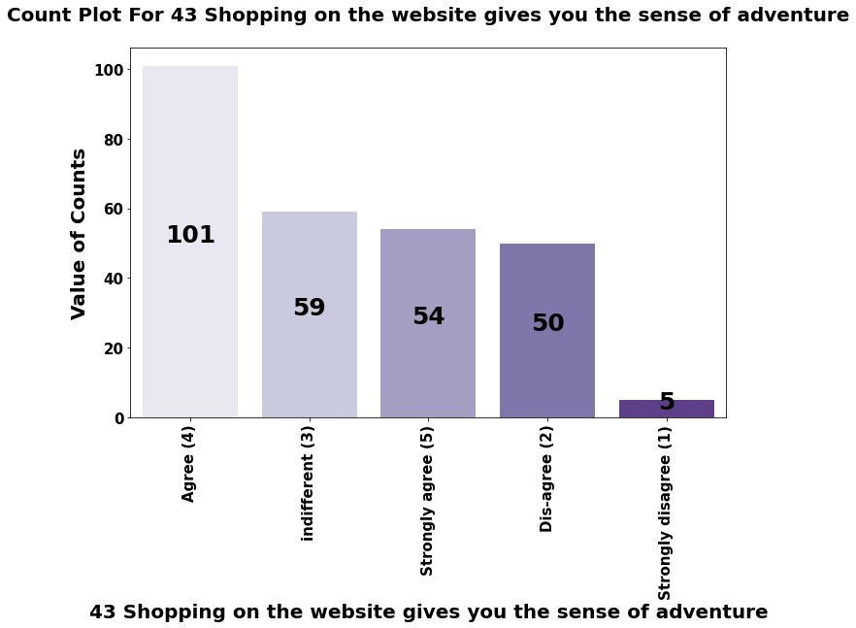

Slide 44
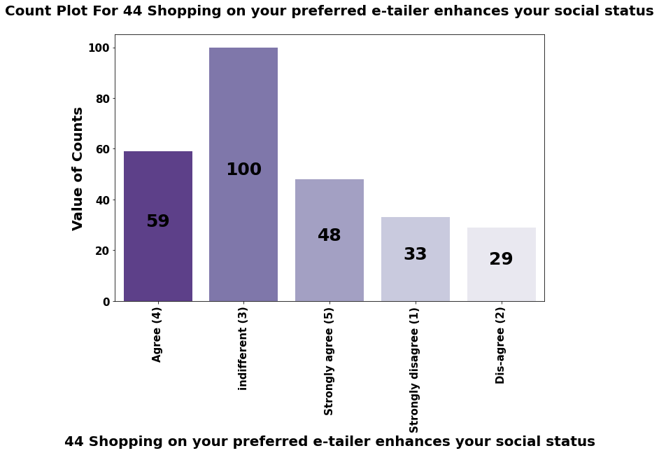

Slide 45
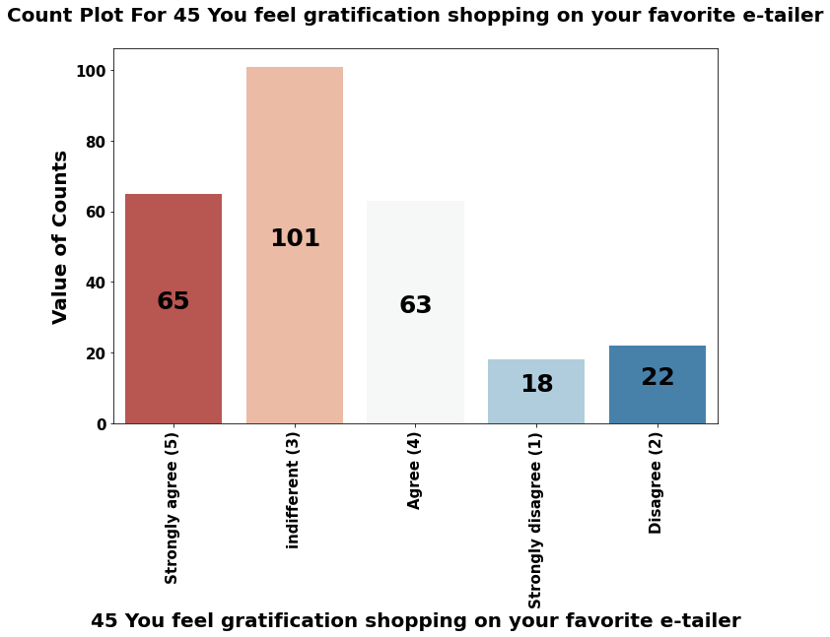

Slide 46
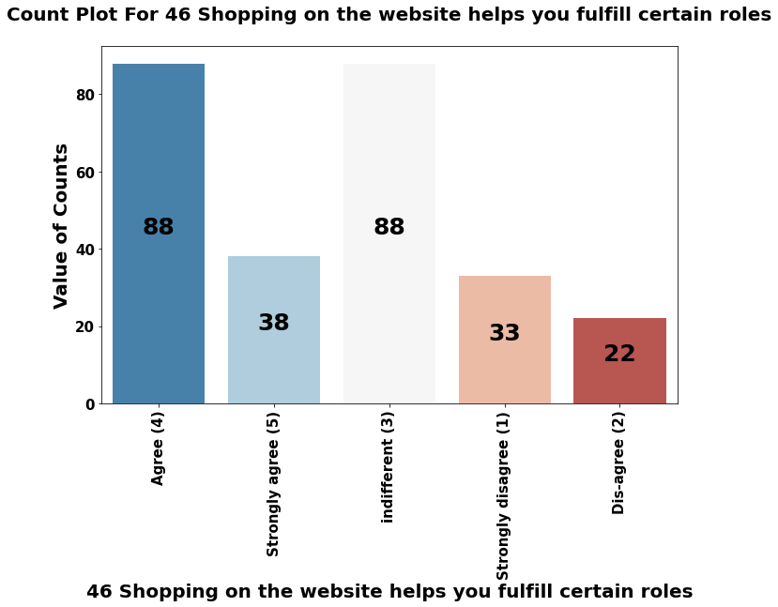

Slide 47
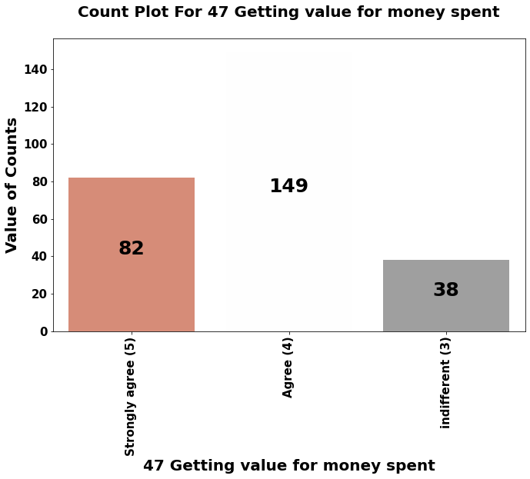

Slide 48
conclusion
As we already discussed that respondents rating has taken in the survey that how an ideal website should be, what features, systems, facilities & benefits of should an E-retail store should have in order to get customer’s response.
We have seen certain things on which people are strongly agree & agree, the count of both strongly agree & agree combined crossed more than 80% people on most of the cases. People are strongly agree on certain things like:-
Website content must be easy to understand, high lightening of the similar product and information is necessary & important, website navigation should be easy, website should be user friendly, payment methods should be convenient, commitment should be fulfilled on time. Privacy, financial security, customer assistance on queries, monetary benefits & discounts are some of the things on which people are strongly agree & agree.
From these analysis here we can conclude that if a E-retail store wants to retain the customers and wants new customer activation then they must focus on these points.

